Slide 1
Introduction to Astar Algorithm
Notes:
The name of the section would be mentioned here.

Slide 2
Calculating Cost
f(n) = g(n) + h(n)
g(n) – Actual cost of traversing from initial state to state n
h(n) – Estimated cost of reaching to the goal from state n

Slide 3
Informed State Space
Given: [S, s, O, G, h] where
S is the (implicitly specified) set of states
s is the start state
O is the set of state transition operators each having some cost
G is the set of goal states
h( ) is a heuristic function estimating the distance to a goal
To find:
Min. cost of sequence of transactions to the goal state

Slide 4
A* Algorithm
Initialize: Set OPEN = {s},
CLOSE = { }, Set f(s) = h(s), g(s)=0
Fail:
If OPEN ={ }, Terminate with Failure
Select: Select the minimum cost state, n, form OPEN and Save n in CLOSE
Terminate:
If n ∈ G, terminate with SUCCESS

Slide 5
A* Algorithm
Expand:
Generate the successors of n using O. For each successor, m, insert m in OPEN only if m ∉ [OPEN ∪ CLOSE]
set g(m) = g(n) + C(n,m)
set f(m) = g(m) + h(m)
insert m in OPEN
if m ∈ [OPEN ∪ CLOSE]
Set g(m) = min{ g(m), g(n)+C(m,n)}
set f(m) = g(m) + h(m)
If f(m) has decreased and m ∈ CLOSE move it to OPEN
Loop: Goto step 2

Slide 6
12
2
10
1
16
2
15
1
2
3
4
3
1
1
3
12
5
7
1
11
5
15
5
6
7
8
1
4
10
15
12
8
4
3
1
1
9
10
11
12
0

Slide 7
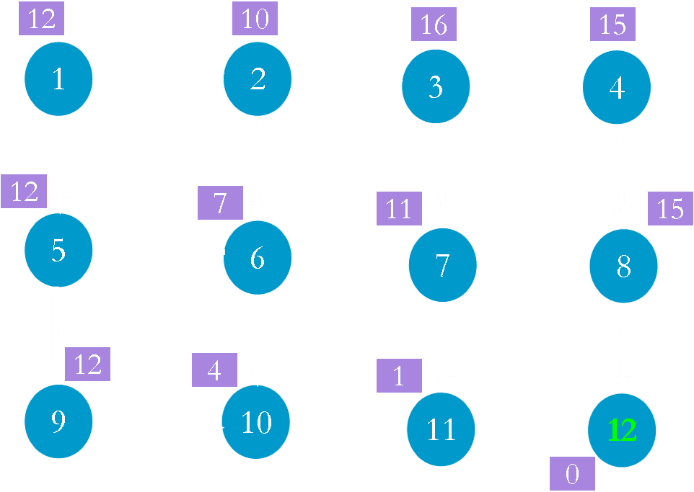
OPEN
1(12)
Node g()
1 0
CLOSE

Slide 8
OPEN
Node g()
1 0
CLOSE
1(12)

Slide 9
OPEN
2(12) 5(13)
Node g()
1 0
2 2
5 1
CLOSE
1(12)

Slide 10
OPEN
5(13)
Node g(n)
1 0
2 2
5 1
CLOSE
1(12) 2(12)

Slide 11
OPEN
5(13) 3(19) 6(12)
Node g()
1 0
2 2
5 1
3 3
6 5
CLOSE
1(12) 2(12)

Slide 12
OPEN
5(13) 3(19)
Node g()
1 0
2 2
5 1
3 3
6 5
CLOSE
1(12) 2(12) 6(12)

Slide 13
OPEN
10(13) 3(19) 5 (13)
7(17)
Node g()
1 0
2 2
5 1
3 3
6 5
7 6
10 9
CLOSE
1(12) 2(12) 6(12)

Slide 14
OPEN
10(13) 3(19) 7(17)
Node g()
1 0
2 2
5 1
3 3
6 5
7 6
10 9
CLOSE
1(12) 2(12) 6(12) 5(13)

Slide 15
OPEN
3(19) 10(13) 7(17)
9(14)
Node g()
1 0
2 2
5 1
3 3
6 5
7 6
10 9
9 2
CLOSE
1(12) 2(12) 6(12) 5 (13)

Slide 16
OPEN
3(19) 7(17) 9(14)
Node g()
1 0
2 2
5 1
3 3
6 5
7 6
10 9
9 2
CLOSE
1(12) 2(12) 6(12) 5 (13)
10(13)

Slide 17
OPEN
3(19) 7(17) 9(14)
11(13)
Node g()
1 0
2 2
5 1
3 3
6 5
7 6
10 9
9 2
11 12
CLOSE
1(12) 2(12) 6(12) 5 (13)
10(13)

Slide 18
OPEN
3(19) 7(17) 9(14)
Node g()
1 0
2 2
5 1
3 3
6 5
7 6
10 9
9 2
11 12
CLOSE
1(12) 2(12) 6(12) 5 (13)
10(13) 11(13)

Slide 19
OPEN
3(19) 7(17) 9 (14)
12 (13)
Node g()
1 0
2 2
5 1
3 3
6 5
7 6
10 9
9 2
11 12
12 13
CLOSE
1(12) 2(12) 6(12) 5 (13)
10(13) 11(13)

Slide 20
OPEN
3(19) 7(17) 9 (14)
Node g()
1 0
2 2
5 1
3 3
6 5
7 6
10 9
9 2
11 12
12 13
CLOSE
1(12) 2(12) 6(12) 5 (13)
10(13) 11(13) 12 (13)

Slide 21
Next Video
Implementation of AStar Search
Notes:
[Mandatory Slide]
Here the name of the next video needs to be mentioned. The narration as you guessed it would be just letting the viewer know exactly where we are at and what we’d be taking over next! ☺

